Slide 1
Advance Track Project
BY- ARYAN CHOUDHARY(170152)
MENTOR - DHAWAL UPADHYAY
INSTRUCTOR IN CHARGE - INDRANIL SAHA, Purushottam Kar

Slide 2
GitHub Repo
https://github.com/aryanc403/AdvanceTrackProject (Public)

Slide 3
Problem
I need a tool that can do the task of online ide.
Which I can use before submitting my solution on online platform like codeforces, codechef, SPOJ etc.
To check the validity of my soln.
And protect my source code, because protection of source code is most important for a programmer.
To avoid being caught in palgarism, which sometimes happens when we forget to make our code private.
https://discuss.codechef.com/questions/18669/what-does-codechef-do-to-prevent-cheating

Slide 4
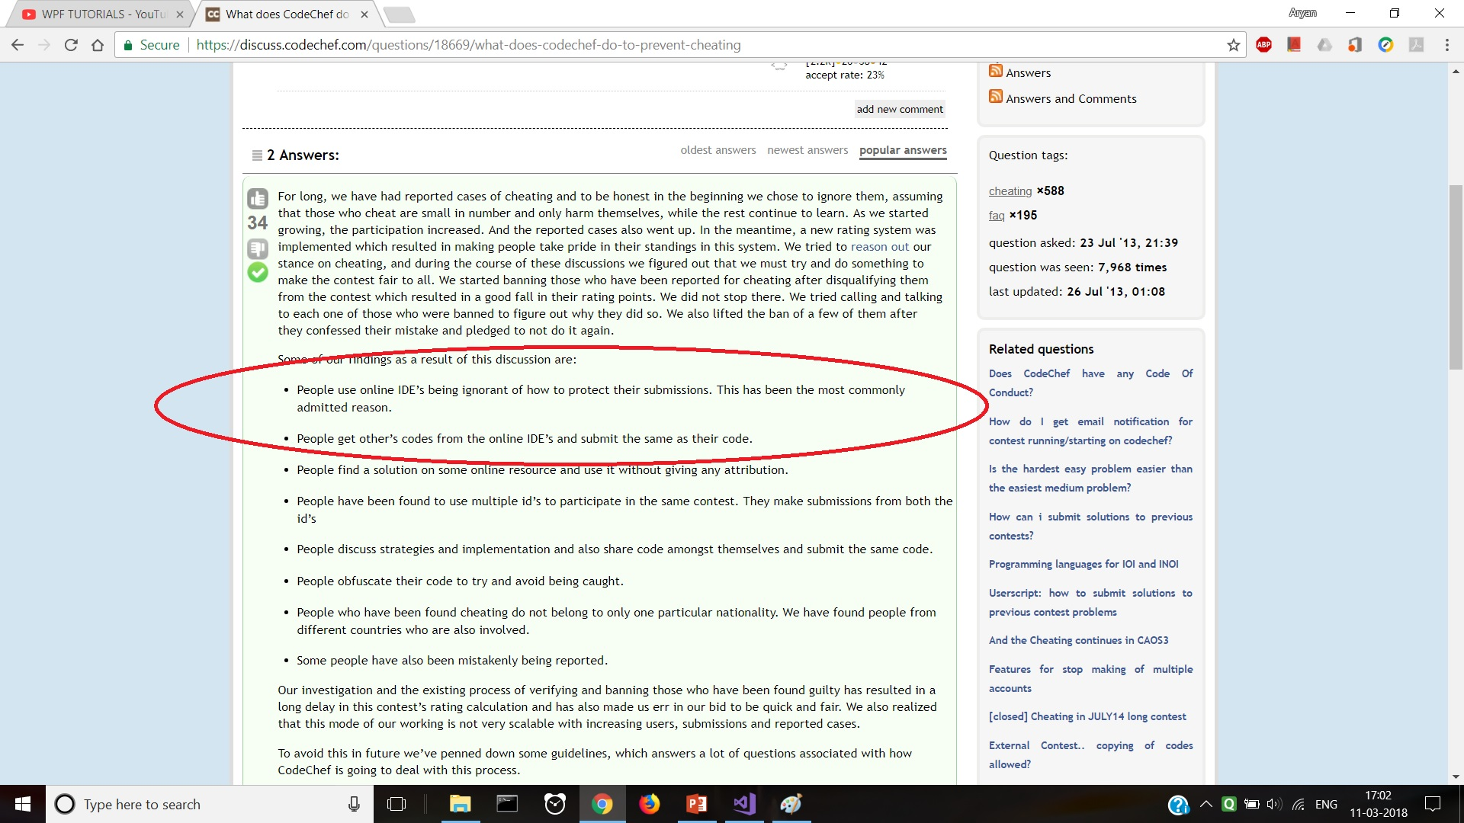

Slide 5
Although those who want to cheat cannot be stopped.
But we can prevent our shelf from being caught in palgarism.
To over come this situation we can use offline ide.
But …

Slide 6
Another problem faced with offline ide is -
We have to select test case online and copy it.
Then we have type again and again sample test cases / other manual case each time when run our code to check our solution.

Slide 7
Typing test cases each time is little bit boring and,
It is also time consuming when the we are on short contest (e.g. 2.5 hrs and 5 question etc.)
We really need to save our time in copying test cases.
And for a platform like codeforces when there are more than one test case. ..

Slide 8
Solution
Although there are may tools available online to solve this problem.
I want to have my own software to serve this purpose.
So, I present to you my project idea.

Slide 9
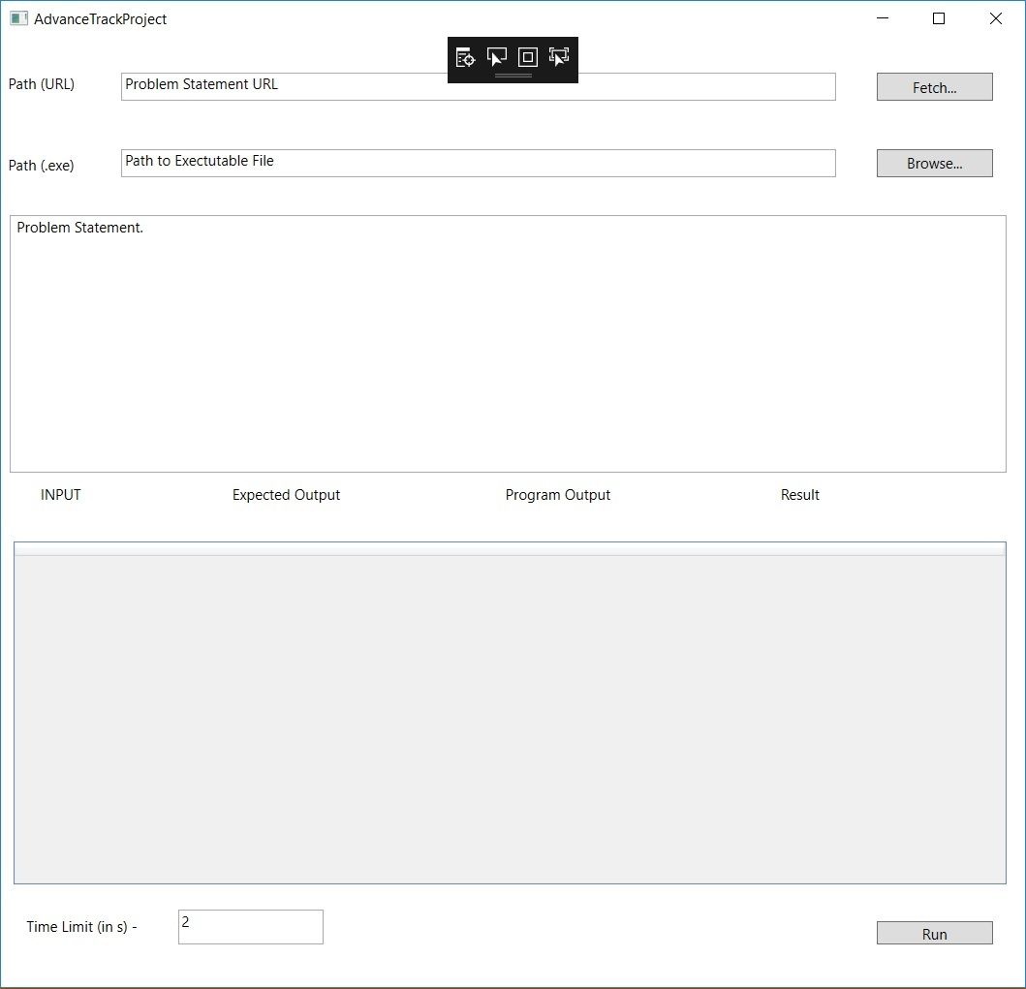

Slide 10
Solution
It will serve as gap between online and offline ide.
My software along with offline ide, can get rid of these problems.

Slide 11
It is an automatic tester for programming contests such as CodeForces rounds.
It will parse the problem statement, extract sample test cases (inputs and outputs) from it, and verify the correctness of your program against them.
It is built to provide maximum automation and to relieve the contestant as much as possible.

Slide 12
Features -
It will parse Entire Problem Statement.
Fetches sample test cases from problem statement.
Allows you to edit, view, add test cases.
Customizable time limits.
Mini version of own ide.
Handles all verdicts WA,TLE, RE, and AC.
Currently supports only C/C++.
Currently runs only on windows.

Slide 13
Tools available and used
Using C# and Microsoft library files.
Creating Web Scrapper to fetch sample test cases.
I am Using HtmlAgilityPack.
For getting html components.
I am Using System.Net and System.Net.Http
Working in Microsoft Visual Studio.

Slide 14
Past work
Yes, People have worked in past on Same problem statement.
They have already released full featured application for public release (4 years ago).
(Although many people do not know about this in our campus :P).
http://codeforces.com/blog/entry/13141 (Acknowledgement - Project Idea).
https://github.com/dj3500/hightail (Original application is created in Java).

Slide 15
Why Problem is Worth Solving again ??
Problem is related to something which every competitive programmer needs/uses to protect his/her code.
It is more fun when you use your own created application to debug your problems.
And most important reason -
This project teaches me process of app development.
How to create web scrapper.
Using Microsoft environment for application development.
And exploring tools provided by Microsoft for Application Development.
And this project will help me. For how to take on self project in future.

Slide 16
Progress (Task Completed)
Tasks Done –
Created WPF Form.
Front End Task Completed.
Front End –
Added Buttons for each task.
Added data grid.
Added functionality of Browse Button.
Added functionality of Fetch Button(Partial).

Slide 17
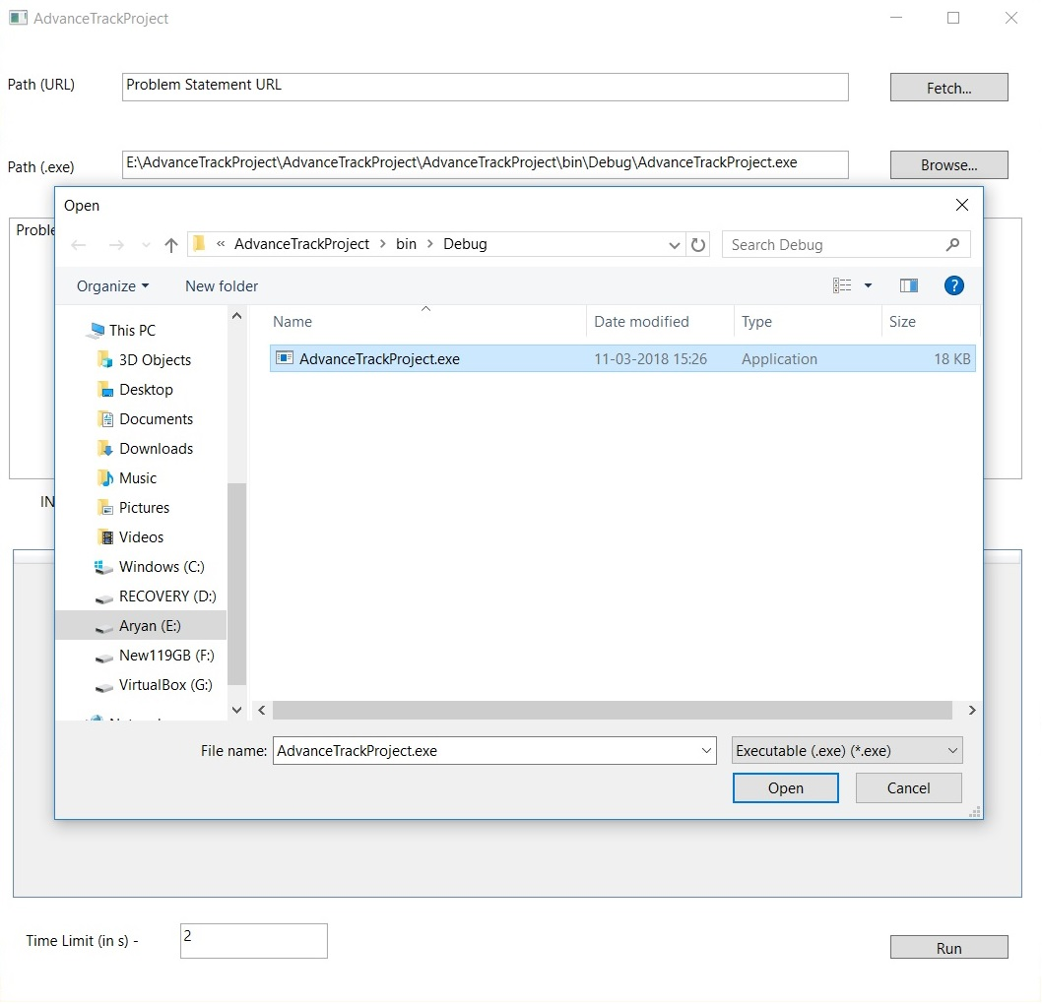

Slide 18
Back End
Work Done –
Added Web Scrapper. (Task Completed).
Until now My Project can fetch Sample Input/Output and add then in a list.
Work To be Done –
Add Content (sample input/output) to data grid.
Input Sample input in stdin, after running program, and capture stdout.
Add feature to Handles all verdicts WA,TLE, RE, and AC.
Allows you to edit, view, add test cases. This is added automatically when I will add rows to data grid.

Slide 19
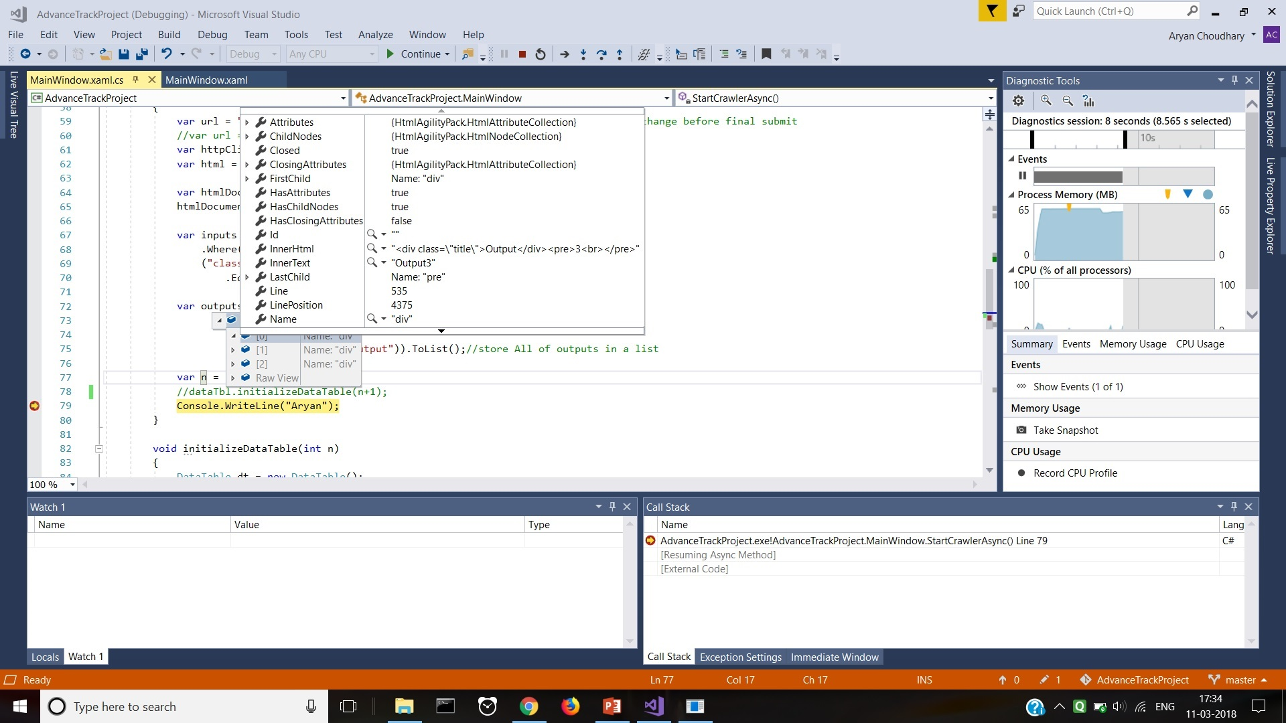

Slide 20
Challenges Faced So Far -
This is my first project (of any kind) related to CSE.
First encounter on application development.
First encounter with Visual Studio.
First hand on experience with C# and OOP.

Slide 21
Steps taken to over come these Challenges -
Watched Youtube Playlists.
Acknowledgement –
https://www.youtube.com/playlist?list=PL3dYK0ZLo-4rZnJSXDeiJVjZtzloOKKmZ
https://www.youtube.com/watch?v=mY4o_E0bilc&t=158s&list=PL4uUzn4lRv77y7h9CT7uSevLk8FrdCbih&index=6
https://www.youtube.com/watch?v=4fGOLn3azZA&t=197s&list=PL4uUzn4lRv77y7h9CT7uSevLk8FrdCbih&index=15
https://www.youtube.com/playlist?list=PL4uUzn4lRv77y7h9CT7uSevLk8FrdCbih&disable_polymer=true
And many more.

Slide 22
Implemented Web Crawler for two different websites, Before using for project to download.
Every command or function before using in project made trial run on other dummy project and seen its output in debug.
And then implemented in project.
More Challenges faced -

Slide 23
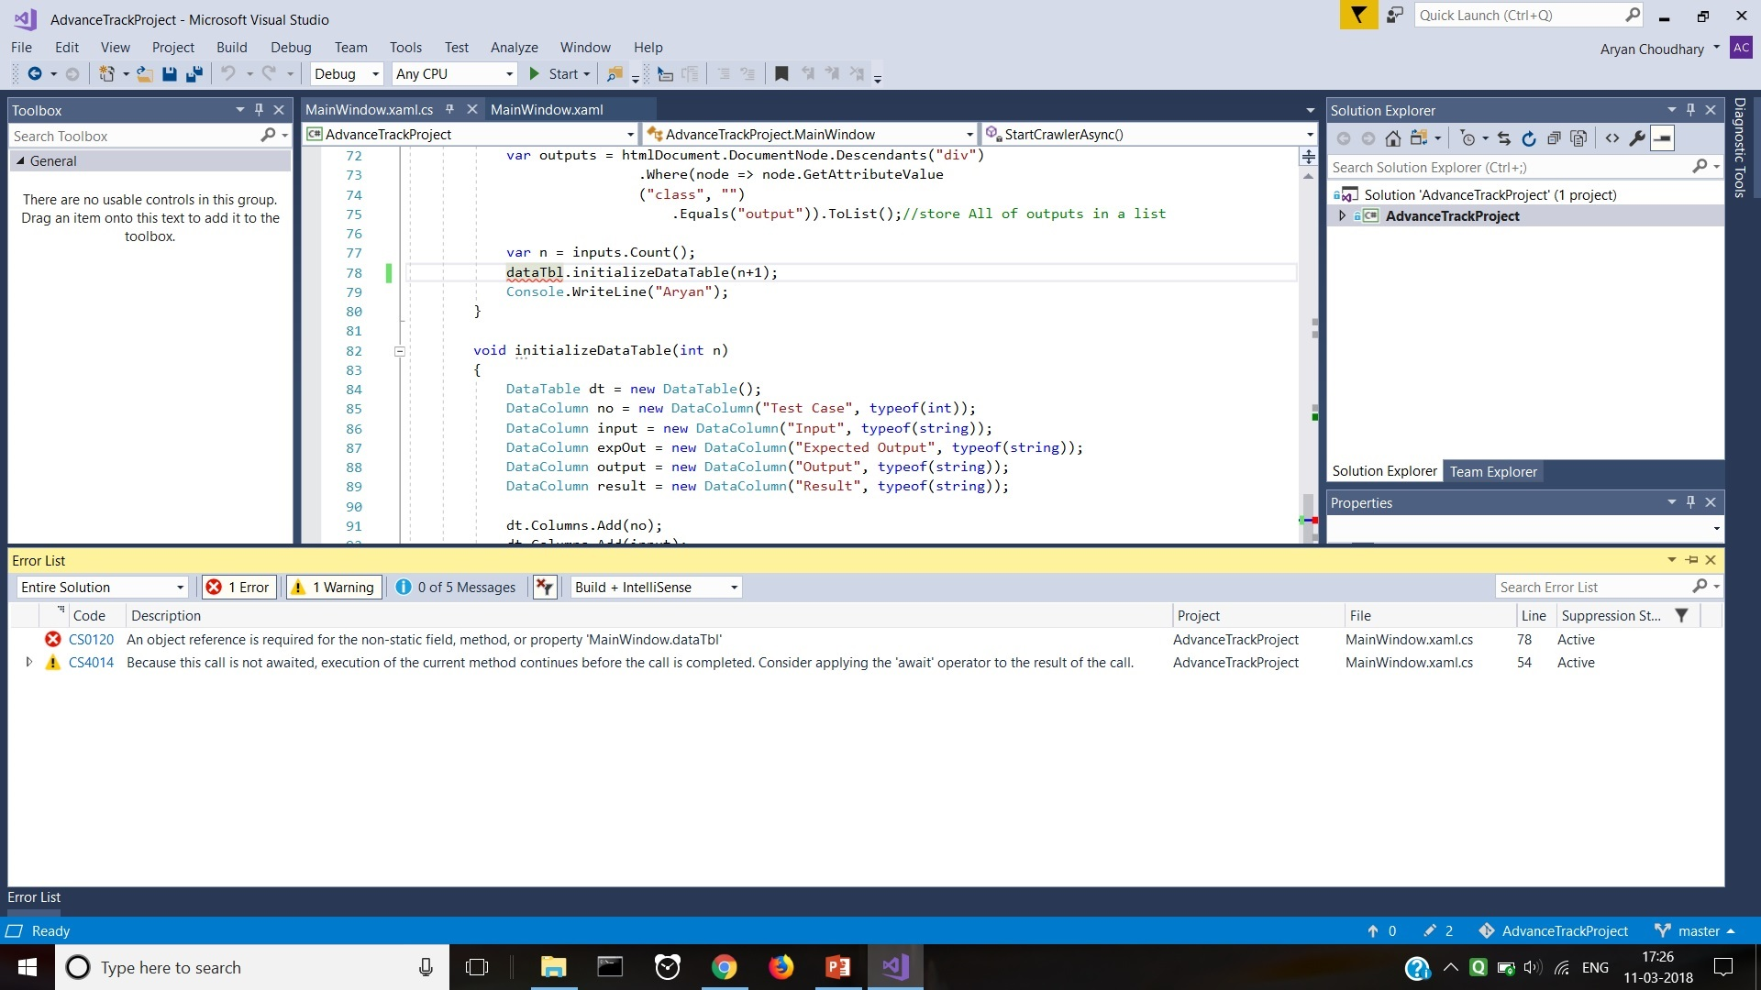

Slide 24
More Challenges facing right now.
Lets recall my features –
Add Sample input in stdin, after running program, and capture stdout.
Handles all verdicts WA,TLE, RE, and AC.

Slide 25
To overcome
Handles all verdicts WA,TLE, RE, and AC.
Solution one –
we can check the return code given by main function.
But There are many types of RE, and handling each is difficult.
And any other runtime error may hault the program.

Slide 26
Add Sample input in stdin, after running program, and capture stdout.
Approach 1 - I am looking for any library function which can do this for me.
Approach 2 – I was told by my TA that in linux, we have command line function which can copy text (What we have typed/What is output).
If cmd (windows) also have this then I can run Program on cmd and capture the output to handle this.

Slide 27
Thank You!!

